Slide 1
2017-18 Budget Update
March 28th, 2017
Notes:
This presentation is an overview of the state’s proposed budget and how it is likely to impact CBSD. The state budget probably will not be finalized until the end of June – at best.

Slide 2
Presentation Overview
Review the Governor’s Budget for 2017-18
Impact of Governor’s Budget on CBSD
Status of CBSD Budget Development

Slide 3
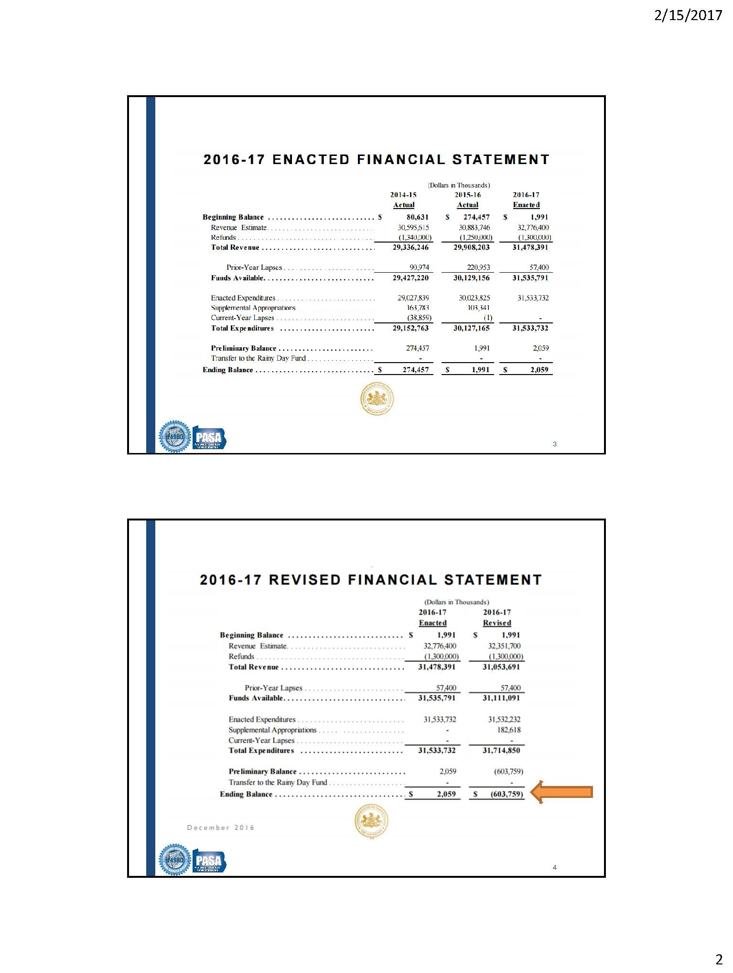
2016-17 Pennsylvania State Budget Overview
As adopted, the current year state budget projected a surplus of $2M

Slide 4
2016-17 Pennsylvania State Budget Overview
The latest state budget projections show a deficit of $600M for 2016-17

Slide 5
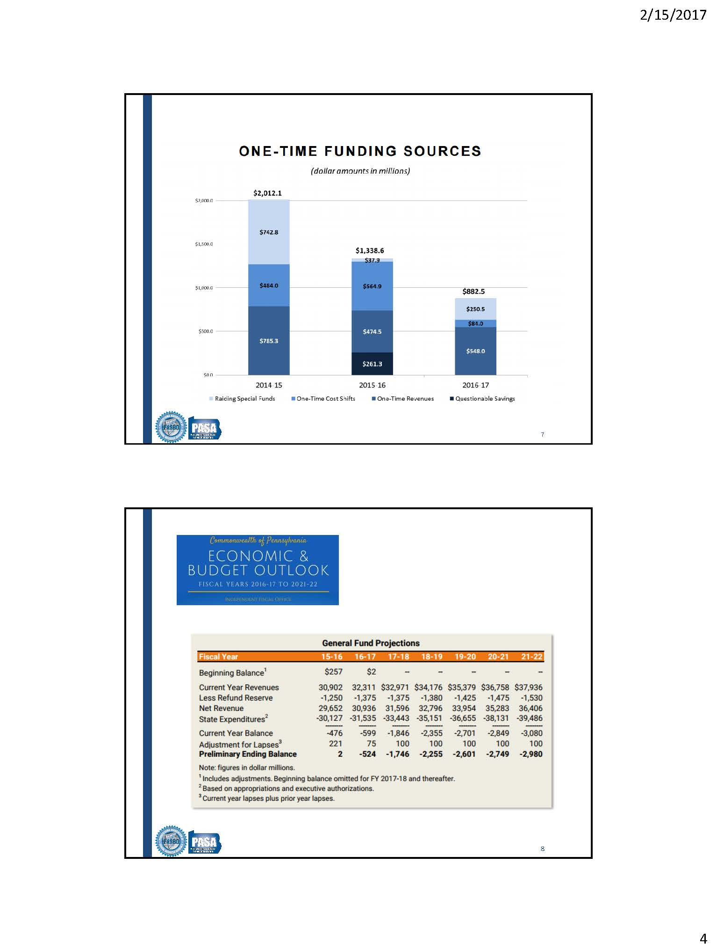
2017-18 Pennsylvania State Budget Overview
The State’s Independent Fiscal Office is Projecting a $1.7B deficit for 2017-18 and growing through 2021-22.

Slide 6
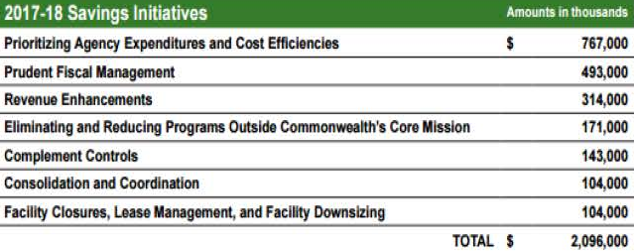
2017-18 Pennsylvania State Budget
The Governor has Identified more than $2B in Cost Savings Across Seven Broad Categories to help balance the 2017-18 budget

Slide 7
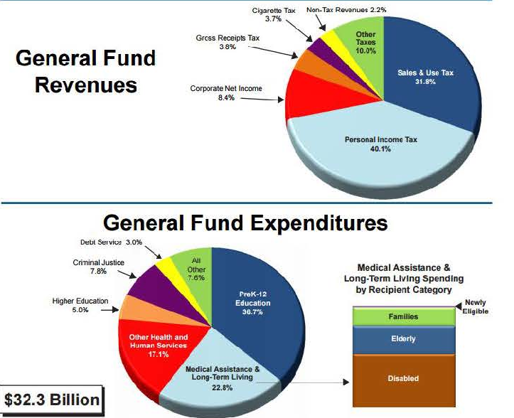
2017-18 Pennsylvania State Budget

Slide 8
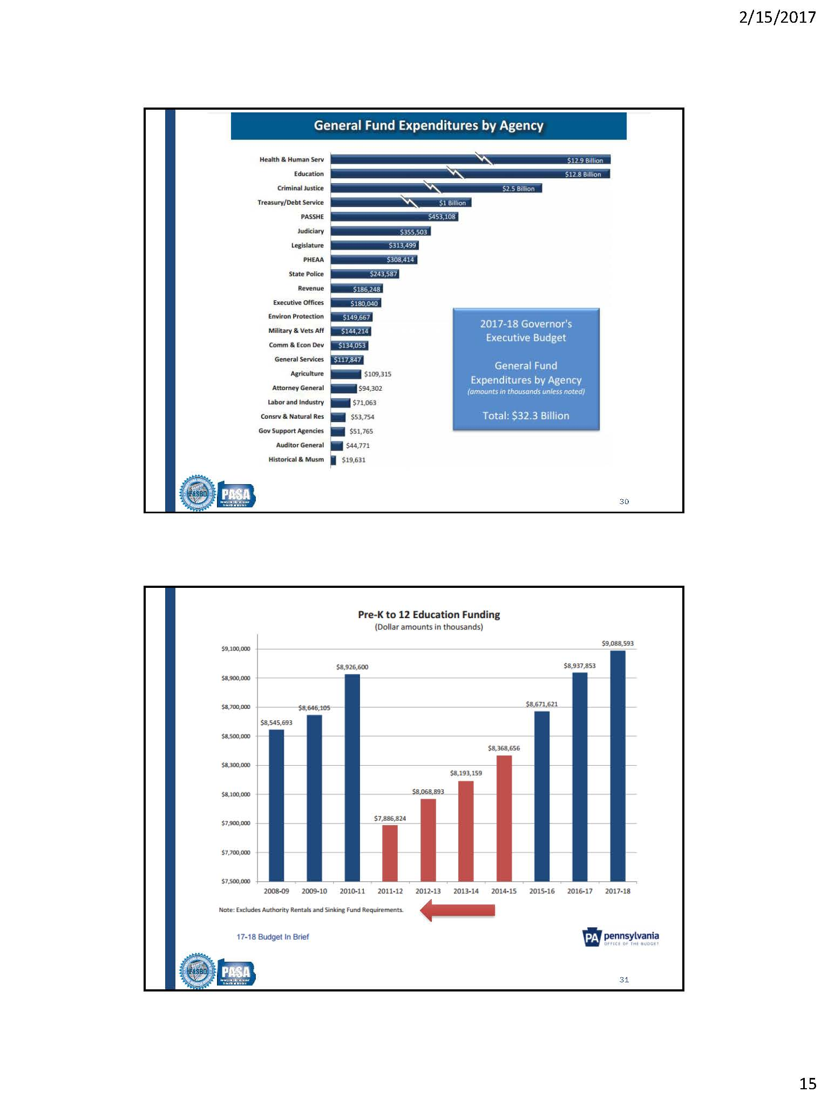
2017-18 Pennsylvania State Budget

Slide 9
2017-18 Pennsylvania State Budget
Most of the increase is associated with the reimbursement for state retirement

Slide 10
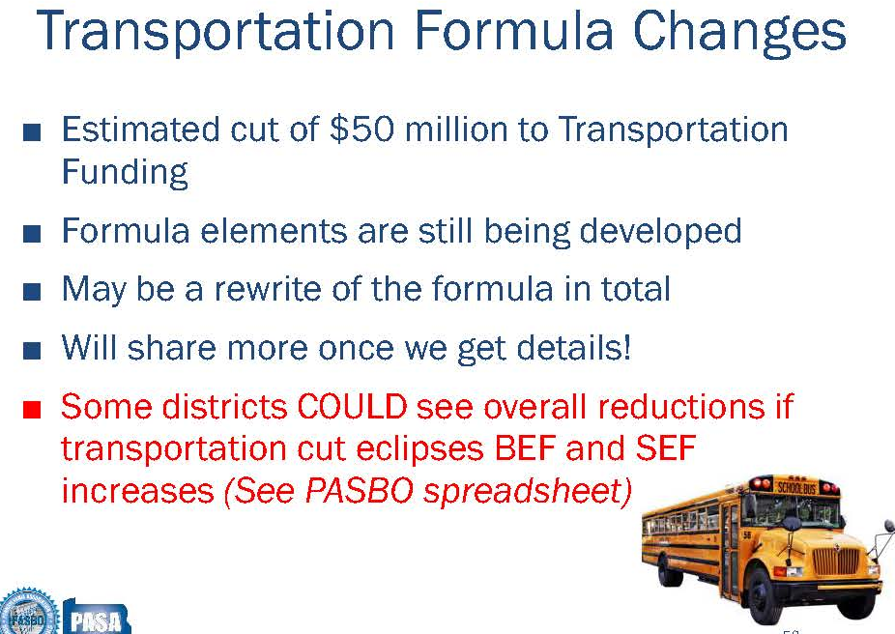
2017-18 Pennsylvania State Budget
( About 11% )

Slide 11
Impact of the Governor’s Budget on CBSD
What are the Projected 2017-18 State Subsidies for CBSD?

Slide 12
2017-18 State/Fed Budget Impact on CBSD

Slide 13
2017-18 CBSD Budget Snapshot: 0 % Tax Increase

Slide 14
Major Goals for the 2017-18 Budget
  No tax increase
  Continue to find ways to minimize the growth in health care costs
  No future borrowing, pay cash for Technology, Buses, and Renovations
  Education Initiatives 2017-18
    Expand iPad carts for grades 3 & 4, laptops in grade 5 & 6
    Expand wireless network access in all buildings
    Focus on student wellness
    Meet the needs of our special education population
    Investigate Middle School curriculum changes to add S.T.E.M.
    Elementary math pilot

Slide 15
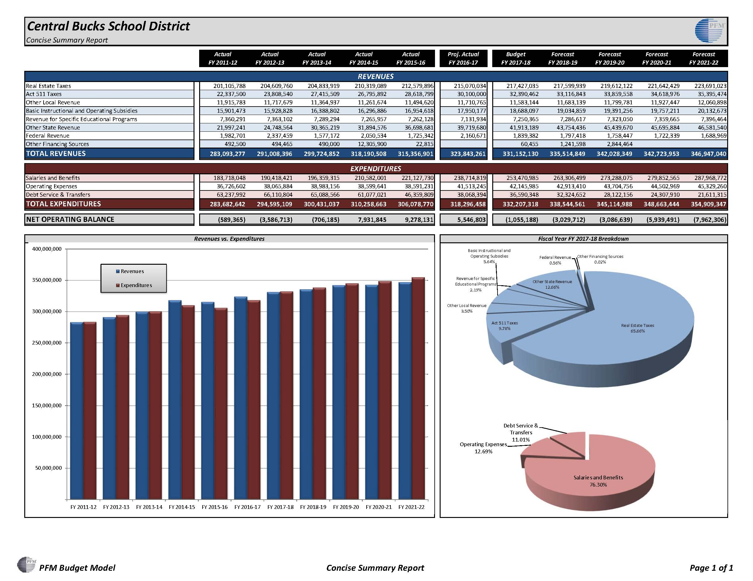
Budget Status for 2017-18

Slide 16
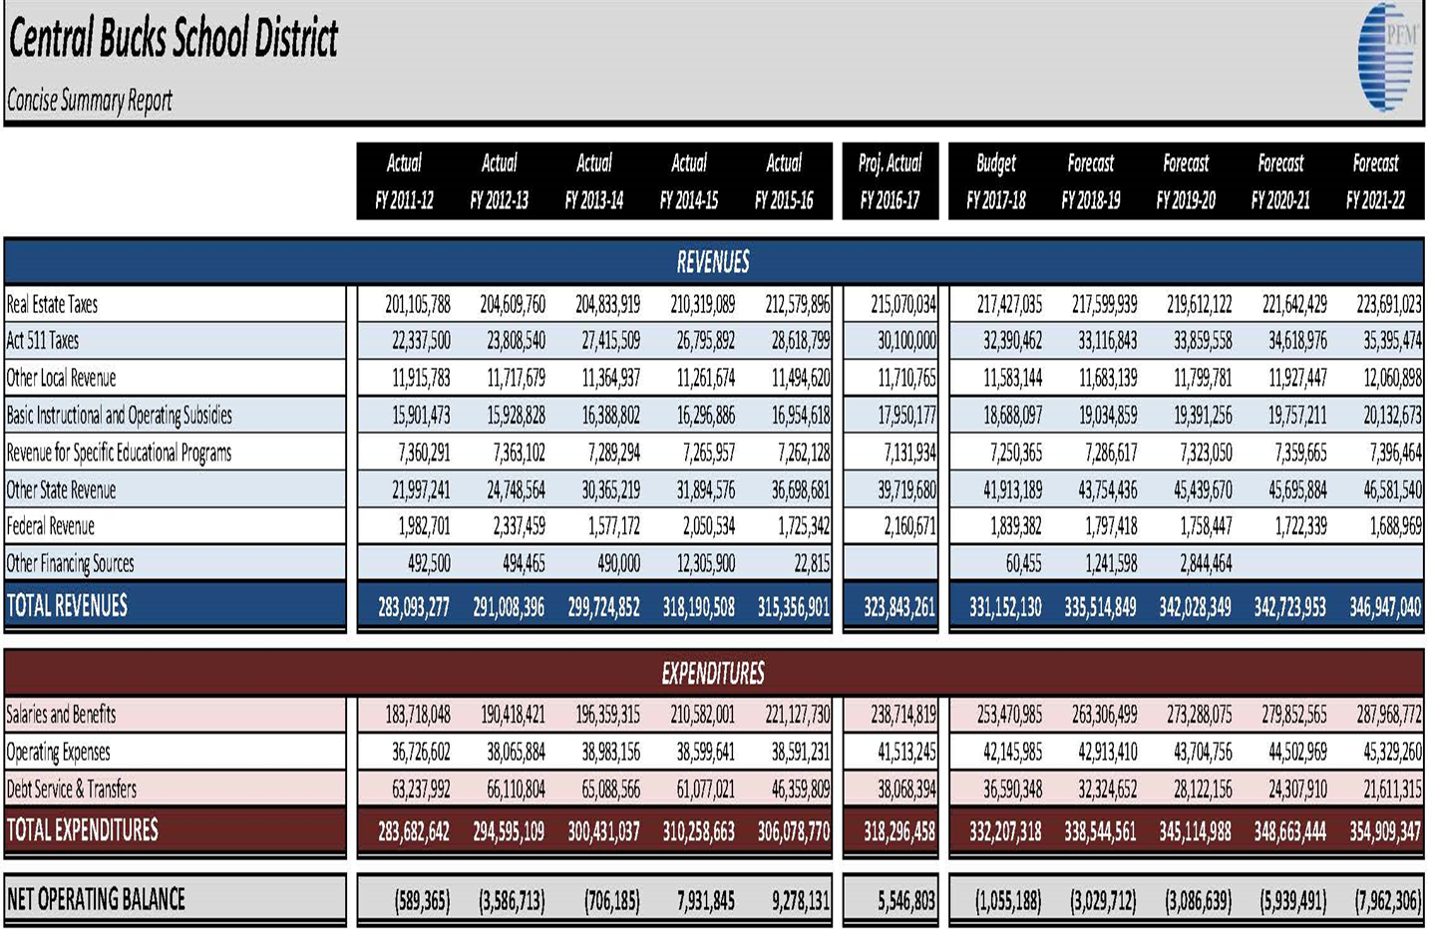
Budget Status for 2017-18 for Revenues
Revenue Changes Since February
Increased EIT revenues by $470,000
Increased Interest Earnings $100,000
Net impact of state and federal subsidies ($60,000)
Revenue growth adjusted over multiple accounts $120,000
$630,000

Slide 17
Budget Status for 2017-18 for Expenses
Expense Changes Since February
100 Salaries: Proposed additional teachers and support staff $1,674,534
200 Benefits: Health, R_{x} , PSERS retirement for new positions $3,222,892
300 Professional Services: small changes to many areas $ (201,217)
400 Property Services: decrease in electricity $ (277,970)
500 Other services: decrease auto, property, liability insurance $ (119,272)
600 Supplies: decrease in natural gas transmission and some others $ (50,514)
700 Equipment: Interest on debt: dues: principal on debt: capital transfers: $ -0- .
Total Changes $4,248,453

Slide 18
Greater Detail for Proposed Changes in Staffing
Other budget areas that are anticipated to grow over the next several years
  Student wellness – social workers 3.0 FTE’s $325,000
  English Language Learners (ELL) Teacher 1.0 FTE, aide position 1.0 FTE $135,000
  Teacher professional development position focused on technology 1.0 FTE $125,000
  Reestablish the office of career readiness for community business internships 1.0 FTE $95,000
  Special Education: add 5 FTE’s for program needs $475,000
  Special education: Certified Behavior Analyst 1.0 FTE $125,000
  State / federal mandates for teacher professional development $20,000
  Health care costs inflation, adding extra $2,000,000 to 2017-18 preliminary budget + new positions
  QUEST at Middle schools 5.0 FTE’s $475,000
  Expand middle school sports grades 7 – 9 (soccer, baseball/softball, basketball, lacrosse) $150,000
  Expand middle school clubs total of approximately 20 EDR’s $32,000
  Add 5 middle school library assistants $ 190,000
  Expand athletic trainers by 3 (for a total of 6) at the high schools $70,000

Slide 19
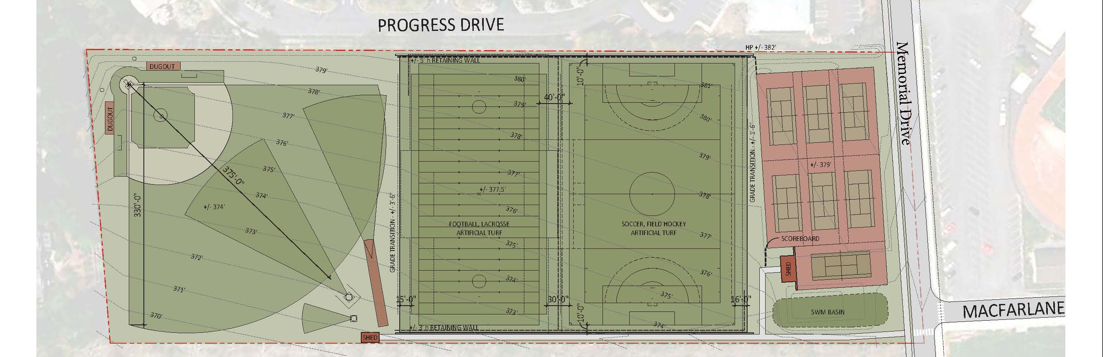
Other Expense Areas for Capital Funding
Greater student access to computers potential growth of $500,000 per year
Build infrastructure for greater wireless network access $1,000,000
CB West athletic fields, improve safety conditions– Option C $3,025,000
  capital funding using $6.6M state construction reimbursement

Slide 20
Act 1 Tax Index + Exceptions

Slide 21
District SAT Scores for 2016 and PDE Tuition Costs
http://www.education.pa.gov/Teachers%20-%20Administrators/School%20Finances/Office%20of%20Comptroller%20Operations/Pages/School-District-Tuition-Rates.aspx#tab-1
http://www.education.pa.gov/K-12/Assessment%20and%20Accountability/Pages/SAT-and-ACT.aspx#tab-1

Slide 22
Next Steps…
  Board of School Directors
  2017-18 Expenditure Increase of 4.37% or $13,900,032 over projected actual
    Retirement expense increasing by $5,028,714 or about 36.2% of the total
  April 25th, Consideration of the Proposed Final Budget
  Final Budget Adoption is Scheduled for June 12th or June 14th?
  Superintendent and Cabinet
  Refine Staffing Needs
  Refine Health Care Numbers
  Refine Revenue Projections
  Refine Expenditure Projections
  Analyze the Legislative Budget Proposals - when available

Slide 23
CBSD

Slide 25
Real Estate Tax Reform for 2017-18

Slide 26
Real Estate Tax Reform
The state house and senate are preparing to introduce legislation that will eliminate school property taxes except those that would pay for existing principal and interest payments on construction debt.
Implementation would be July 1, 2017
To replace most school district real estate taxes, the state would need to shift the burden on to other tax sources. Based upon past legislative bills, it is estimated that:
  The state Personal Income Tax (PIT) would increase from 3.07% to 4.95%
  The sales and use tax (SUT) would increase from 6% to 7% and include most food and clothing as well as services such as legal, mental health, architects, etc.
Under the tax shift, school districts would receive state subsidies equal to the amount of real estate tax they received during 2016-17 less the grandfathered real estate taxes for construction debt.

Slide 27
Real Estate Tax Reform
School districts would receive yearly increases equal to the lessor of the State Average Weekly Wage or the increases for (SUT, PIT and hotel occupancy taxes averaged together )
With voter approval via a referendum, school districts would have limited ability to raise some taxes by increasing the local Earned Income Tax (EIT) or Personal Income Tax (PIT).
School districts can’t issue any future debt without voter referendum
The state would look at school district debt payments each year
  No incentive to have declining debt payments under this proposal

Slide 28
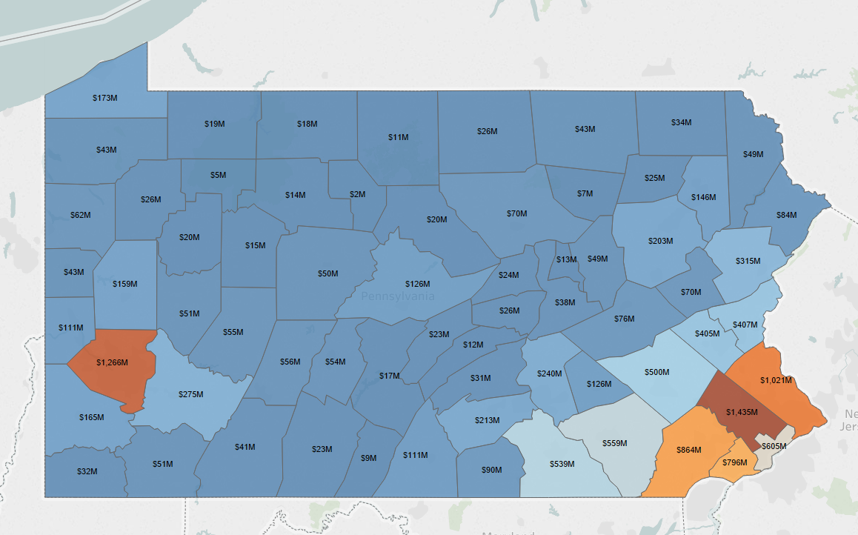
Implications of Real Estate Tax Reform
Local tax dollars won’t stay local any longer
Most of the new taxes will flow to just 6 counties

Slide 29
Implications of Real Estate Tax Reform continued
The new equitable basic state education funding formula would be essentially eliminated
Tax shift from businesses to individuals
  According to a 2012 analysis by the state Independent Fiscal Office (IFO) businesses pay about $3B in real estate taxes statewide
  By reducing real estate taxes, business will shift about $2B of their real estate tax burden on to individual tax payers statewide
Eliminates most of the local control and funding authority
  How will hiring decisions be made?
  How will contracts be negotiated?
School facilities are likely to deteriorate over time
How will PSERS and health care expenses be paid for when they are increasing greater than the general rate of inflation?

Slide 30
Implications of Real Estate Tax Reform continued
Real estate tax write-offs on federal taxes will be significantly reduced giving greater revenues to the federal government from Pennsylvania.
  Will this also impact the value of housing in Pennsylvania?
A recession will have a much larger impact on school district finances without the stability of real estate taxes
  School districts can’t layoff teachers for economic reasons
Budget timelines would need to change
  Since most funding would come from the state
  No time for school districts to adjust spending proposals assuming a June 30th state budget adoption
Where will some of the new tax dollars go?
  $250,000,000 to the Transportation Assistance Fund
  Will other competing interest also siphon away some education dollars in the future?

Slide 31
Implications of Real Estate Tax Reform continued
Does not address the factors driving school expenses
  PSERS
  Charter schools
  Special education
  Health care
The state Independent Fiscal Office estimates a $14B tax shift will need to occur.
Real estate tax reform probably helps senior citizens
Real estate tax reform might hurt lower income families

Slide 32
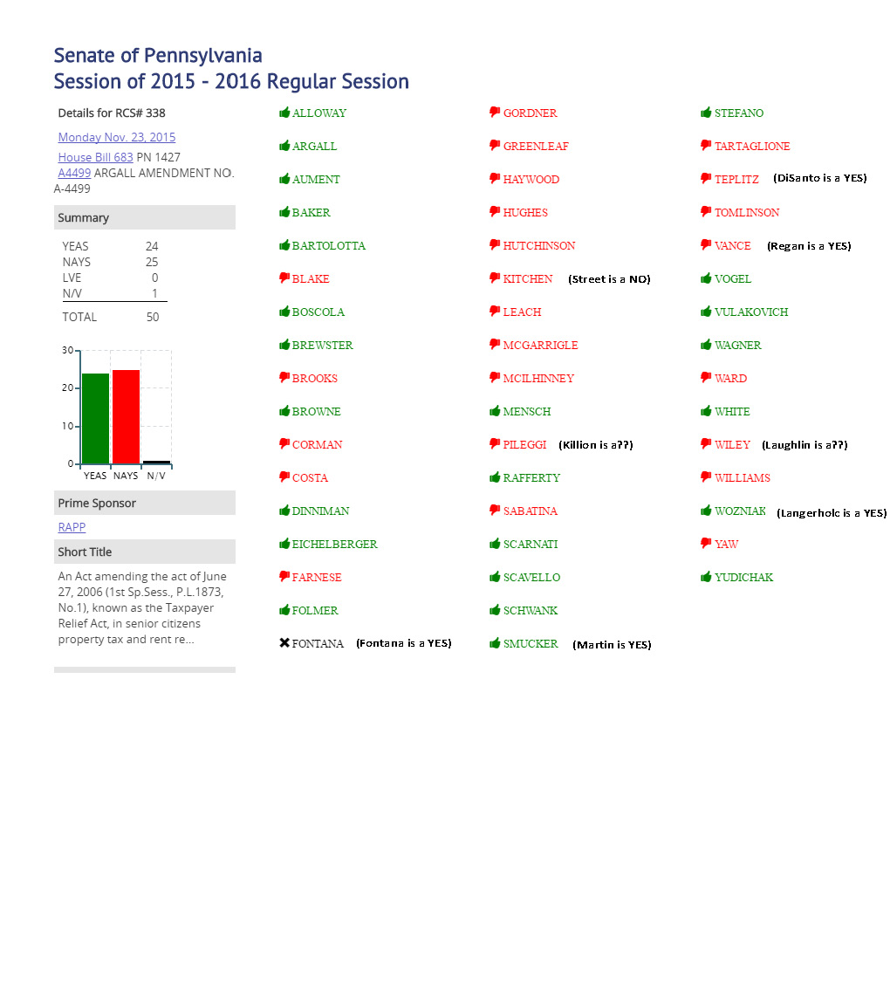
Implications of Real Estate Tax Reform continued
Last Year the senate narrowly defeated property tax elimination by 1 vote

Slide 33
Implications of Real Estate Tax Reform continued
Last Year the senate narrowly defeated property tax elimination by 1 vote
Moving forward, looks like the senate and house have the votes needed this year

